Slide 1

CAPM
Introduction to CAPM(Cloud Application Programming Model)

Slide 2
What is CAPM
SAP Cloud Application Programming Model is a modern, open-source development framework for building enterprise applications in the cloud.
It provides developers with an easy way to create and deploy robust applications that can be used across multiple SAP products, including ERP, CRM, and HANA.
SAP has provided libraries of JAVA and Node.js to implement simple business logic, using these libraries the developer can implement middleware that will directly integrate with the CDS views to define entities and services, which assures easy development and maintenance. Since CDS is an easy way of exposing the data from HANA tables, development time for CAPM is considerably reduced.
SAP CAPM is a framework of languages (Java and Node.js), libraries (CDS-Core Data Services, Developments Kits), and tools (Visual Studio, Business Application Studio). It is an opinionated and open framework to build the application efficiently

Slide 3
CAPM – Cloud Application Programming Model
CAPM is a framework of languages (Java, NodeJS), libraries (node modules - CDS), and tools (BAS, VSCode, @sap/cds-dk) for building Enterprise grade Cloud-native Applications in SAP BTP.
https://cap.cloud.sap/docs/
Concept of CDS – Core Data & Services
Conceptually CDS is same concept but different flavor. The concept says, that we will have a design time object which is named as CDS File. We will create a .cds file for almost everything e.g. service, db artefact, annotation. This is a design time file and the SAP’s framework (CAPM, RAP), will convert this design time definition after compilation to the runtime object.
CAPM
(CDS Engine)
Node Dependency
Application (package.json)
SQL Code
File.cds (definition)
Entity orders{
Id integer;
Company string;
Amount decimal(12,2);
}

Slide 4
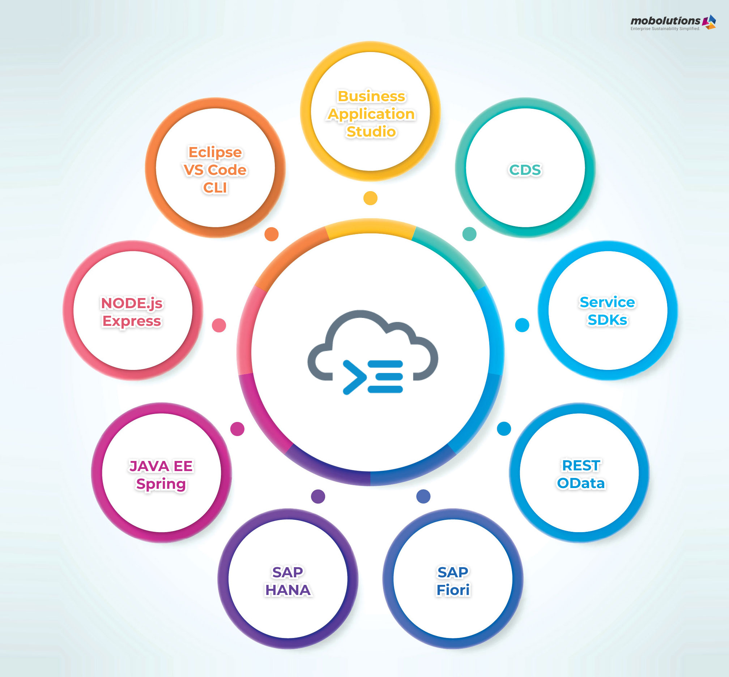

Slide 5
Benefits of Cloud Application Programming Model
SAP CAPM provides several benefits for business scenarios that can be developed and deployed in the cloud environment. The key features are shown below:
Flexibility: When we develop the application using the CAP which uses SQLite database for development, without changing much code we could move the application to production in HANA DB.
Efficiency & Productivity: The CAPM will reduce the complexity for the developer when compared to traditional app development and allows for an increase in the efficiency of the application and productivity will also be improved due to reduced loading time.

Slide 6
Benefits of Cloud Application Programming Model
Enhanced: The CAPM projects can be enhanced easily and deployed in the SAP Cloud Foundry. The cloud foundry provides flexibility for running and maintaining our applications.
Improved Security: Cloud Application Programming Models provide built-in security features, such as encryption, secure communication protocols, and access control. This protects applications and data from security threats. When compared to the ideal technologies that are available, CAPM provides high levels of data security.

Slide 7


